Slide 1
Unit 5: Migrating Virtual Machines

Slide 2
Migrating Virtual Machines, comparison of migration types, cold migration, vSphere vMotion Migration, how vSphere vMotion Migration works, virtual machine requirements for vSphere vMotion Migration, host requirements for vSphere vMotion Migration, vSphere storage vMotion migration, how vSphere storage vMotion works, shared nothing vSphere vMotion, cross vSwitch vMotion, cross vCenter vMotion, Long distance vMotion

Slide 3
Migrating Virtual Machines
VM Migration refers to the process of moving a running virtual machine or application between different physical machines without disconnecting the client or application. Memory, storage, and network connectivity of the virtual machine are transferred from the original guest machine to the destination.
In simpler words, moving a virtual machine from one host to another.

Slide 4
The available migration types are:
Cold – migrates a powered-off VM.
Suspended – migrates a suspended VM.
vSphere vMotion – migrates a powered-on VM.
vSphere Storage vMotion – migrates a powered-on VM’s files to another datastore.

Slide 5
Different migration types can be used for different purposes. For example, if you want to stop an ESXi host but keep the virtual machines running, the vSphere vMotion should be used, but there is one thing you need to be aware of – vMotion requires shared storage.

Slide 6
In Vmware vCenter Server you have following migration options:
Cold Migration: Moving a powered-off virtual machine to a new host. Optionally you can relocate configuration and disk files to new storage locations. You can use cold migration to move VMs from one data center to another.
Migration with Vmware vSphere vMotion: Moving a powered-on virtual machine to a new host. With vSphere vMotion migration, you can move a virtual machine to a new host without interruption in the availability of the virtual machine. You cannot use vSphere vMotion migration to move virtual machine from one data center to another.

Slide 7
Migration with VMware vSphere storage vMotion : Moving the virtual machine and its disk files from one datastore to another while the virtual machine is running. With vSphere storage vMotion migration, you can move a virtual machine’s storage without interruption in the availability of the virtual machine.
Shared nothing vSphere vMotion: A special case of vSphere vMotion where a powered-on virtual machine is moved to a new host and its virtual disks or configuration file is moved to a new datastore in the same operation.

Slide 8
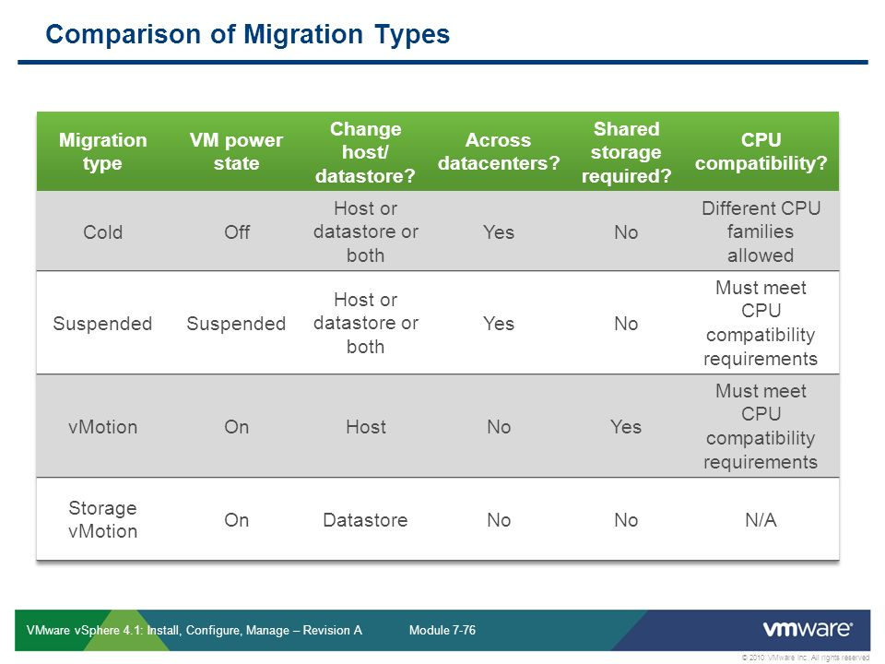

Slide 9
Cold Migration
You use cold migration when a virtual machine is powered off. You use cold migration for some special situations such as moving a virtual machine between ESXi hosts that use different CPU families.
With cold migration, you have the option of moving a virtual machine’s associated disks from one datastore to another. Cold migration can move virtual machines or files in the following ways:
A virtual machine from one Vmware ESXi host to another ESXi host
A virtual machine’s files from one ESXi host to another ESXi host.
A virtual machine and its files from one ESXi host to another ESXi host.

Slide 10
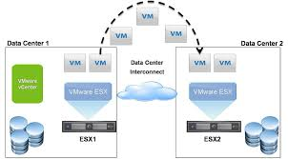

Slide 11
vSphere vMotion Migration
vSphere vMotion migration moves a powered-on virtual machine from one host or server to another. You can use vSphere vMotion to perform the following tasks:
Improve overall hardware utilization.
Enable continued virtual machine operation while accommodating scheduled hardware downtime.
Enable VMware vSphere Distributed Resource Scheduler to balance virtual machines across hosts.

Slide 12
vMotion Migration Types
With vMotion, you can change the compute resource on which a virtual machine is running. You also can change both the compute resource and the storage of the virtual machine.
When you migrate virtual machines with vMotion and choose to change only the host, the entire state of the virtual machine is moved to the new host. The associated virtual disk remains in the same location on storage that must be shared between the two hosts.
When you choose to change both the host and the datastore, the virtual machine state is moved to a new host and the virtual disk is moved to another datastore. vMotion migration to another host and datastore is possible in vSphere environments without shared storage.
After the virtual machine state is migrated to the alternate host, the virtual machine runs on the new host. Migrations with vMotion are transparent to the running virtual machine.
When you choose to change both the compute resource and the storage, you can use vMotion to migrate virtual machines across vCenter Server instances, data centers, and subnets.

Slide 13
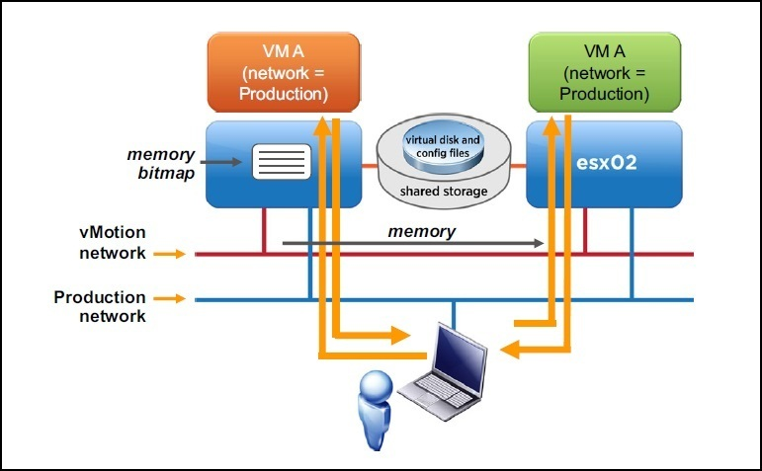
How vSphere vMotion Migration Works

Slide 14
vSphere vMotion works by migrating the entire state of a virtual machine from one host to another, including the memory content and all the information that define the virtual machine, such as BIOS, devices, MAC addresses, etc.
In the picture above you can see that the VM is being transferred from the source ESXi host to the destination ESXi host

Slide 15
A vSphere vMotion migration consists of the following steps:
An ESXi administrator initiates a vMotion migration.
2. The VM’s memory state is copied from the source to the destination ESXi host over the vMotion network. Users continue to access the VM and update pages in memory. A list of modified pages is kept in a memory bitmap on the source host. This process occurs iteratively.
3. After the VM’s memory is copied to the target host, the VM on the source host is quiesced. This means that it is still in memory but is no longer servicing client requests for data. The memory bitmap file and the VM device state is then transferred to the target.
4. The destination host (esx02) reads the addresses in the memory bitmap file and requests the contents of those addresses from the source host.
5. After the content of the memory referred to in the memory bitmap file is transferred to the destination host, the VM starts running on that host. A Reverse Address Resolution Protocol (RARP) message is sent to notify the subnet that the VM’s MAC address is now on a new switch port.
6. After the VM is successfully operating on the destination host, the memory the VM was using on the source host is marked as free.

Slide 16
VM Requirements for vSphere vMotion Migration
Before performing a vSphere vMotion migration, ensure that the following conditions are met:
VM requirements
the VM must not have a connection to an internal standard switch.
the VM must not be connected to any device physically available to only one ESXi host, such as disk storage, CD/DVD drives, floppy drives, and serial ports.
the VM must not have a CPU affinity configured.
the VM must have all disk, configuration, log, and NVRAM files stored on a datastore accessible from both ESXi hosts.
if the VM uses RDM, the destination ESXi host must be able to access it.

Slide 17
Host requirements
shared storage is required. VM files on a VMFS or NFS datastore need to be accessible by both the source and destination ESXi host.
at least a Gigabit Ethernet network interface card with a VMkernel port enabled for vMotion on each ESXi host is required.
identically named virtual machine port groups connected to the same network. All port groups to which the VM is attached must exist on both ESXi hosts. Note that the port group naming is case sensitive.
CPUs in both ESXi hosts must be compatible. CPUs need to be from the same vendor (AMD or Intel, for example), CPU family, and must support the same features. Note that some features CPU features can be hidden by using compatibility masks.

Slide 18
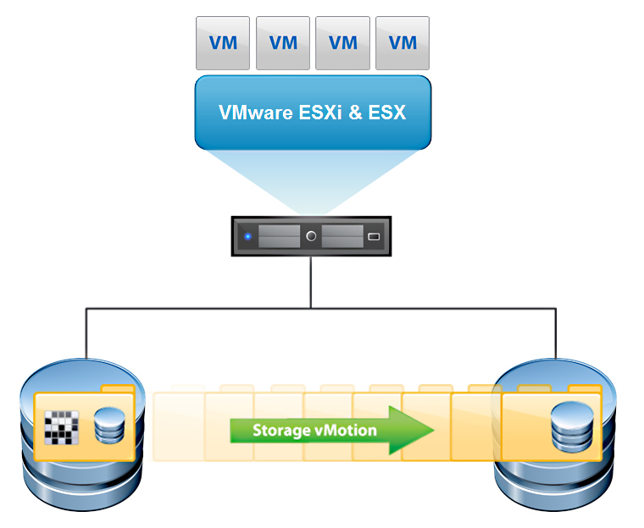
vSphere Storage vMotion Migration

Slide 19
A vSphere storage vMotion migration moves a virtual machine and its disk files from one datastore to another while the virtual machine is running.
vSphere storage vMotion is used for the following tasks:
Moving virtual machines off a storage device to enable maintenance or reconfiguration of the storage device without virtual machine downtime.
Manually redistributing virtual machines or virtual disks to different storage volumes to balance capacity and improve performance.
Evacuating physical storage that is soon to be retired, such as storage arrays whose maintenance and release cycles are coming to an end.
Storage tiering : Moving virtual machines to tiered storage with different service levels due to changing business requirements for that virtual machine.
Upgrading datastores without virtual machine downtime: You can migrate running virtual machines from a Vmware vSphere VMFS3 datastore to a VMFS5 datastore and upgrade the VMFS3 datastore without affecting virtual machines. You can then use vSphere Storage vMotion to migrate virtual machines back to the original datastore without virtual machine downtime.

Slide 20
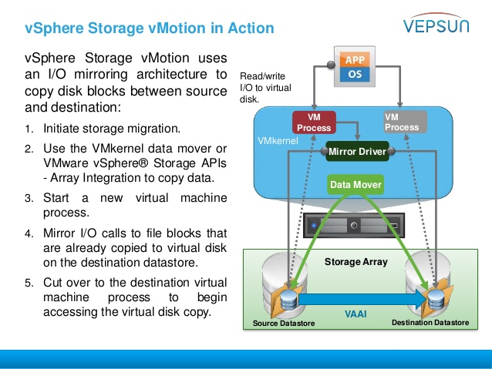
How vSphere Storage vMotion Works

Slide 21
vSphere Storage vMotion in Action vSphere Storage vMotion uses an I/O mirroring architecture to copy disk blocks between source and destination:
1. Initiate storage migration.
2. Use the VMkernel data mover or VMware vSphere® Storage APIs - Array Integration to copy data.
3. Start a new virtual machine process.
4. Mirror I/O calls to file blocks that are already copied to virtual disk on the destination datastore.
5. Cut over to the destination virtual machine process to begin accessing the virtual disk copy. Mirror Driver Data Mover VM Process VM Process Read/write I/O to virtual disk. Destination DatastoreSource Datastore VAAI Storage Array VMkernel

Slide 22
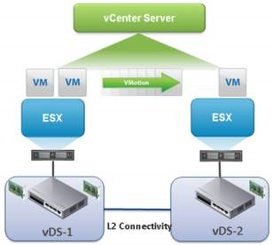
Shared-Nothing vSphere vMotion

Slide 23
With shared-nothing vSphere vMotion, you can change a virtual machine’s datastore and host simultaneously even if the two hosts do not share storage.
vSphere vMotion migration and vSphere storage vMotion migration are combined into a single operation.

Slide 24
Cross-vSwitch vMotion
Cross vSwitch vMotion allows you to seamless migrate a virtual machines across different virtual switches while performing a vMotion. This means that you are now longer restricted by the network you created on the vSwitches in order to vMotion a virtual machine.
With this new functionality you can now migrate a virtual machine to a new cluster with a separate vDS without interruption for instance during datacenter migrations. This further increases agility, reducing the time it takes to replace/refresh hardware and increases availability during planned maintenance activities.
For this to work you need the source and destination portgroups to share the same L2. The IP address within the VM will not change.

Slide 25
vMotion will work across a mix of switches (standard and distributed). Previously, you could only vMotion from vSS to vSS or within a single vDS. This limitation has been removed. The following Cross vSwitch vMotion migrations are possible:
vSS to vSS.
vSS to vDS.
vDS to vDS.
vDS to VSS is not allowed.

Slide 26
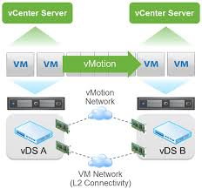
Cross vCenter vMotion

Slide 27
Like with vSwitch vMotion, Cross vCenter vMotion requires L2 network connectivity since the IP of the VM will not be changed. This functionality builds upon Enhanced vMotion and shared storage is not required. Target support for local (single site), metro (multiple well-connected sites), and cross-continental sites.
With vSphere 6 vMotion you can now:
Migrate from a VCSA to a Windows version of vCenter & vice versa.
Replace/retire vCenter server without distruption.
Resource pooling across vCenters where additional vCenters were used due to vCenter scalability limits.
Migrate VMs across local, metro, and continental distances.
Public/Private cloud environments with several vCenters.

Slide 28
There are several requirements for Cross vCenter vMotion to work:
Only vCenter 6.0 and greater will be supported. All instances of vCenter prior to version 6.0 will need to be upgraded before this this feature will work. For example, an instance of vCenter 5.5 and 6.0 will not work.
Both the source and the destination vCenter servers will need to be joined to the same SSO domain if you want to perform the vMotion using the vSphere Web Client. If the vCenter servers are joined to different SSO domains, it’s still possible to perform a Cross vCenter vMotion, but you must use the API.
You will need at least 250 Mbps of available network bandwidth per vMotion operation.
Lastly, although not technically required for the vMotion to successfully complete, L2 connectivity is required on the source and destination portgroups. When a Cross vCenter vMotion is performed, a Cross vSwitch vMotion is done as well. The virtual machine portgroups for the VM will need the share an L2 network because the IP will within the guest OS will not be updated.

Slide 29
Long-Distance vMotion
Long Distance vMotion is an extension of Cross vCenter vMotion however targeted for environments where vCenter servers are spread across large geographic distances and where the latency across sites is 100ms or less.
Although spread across a long distance, all the standard vMotion guarantees are honored.

